Slide 1
twitch.time
A tale of Time series forecasting, chaos and
Derek Freund

Slide 2
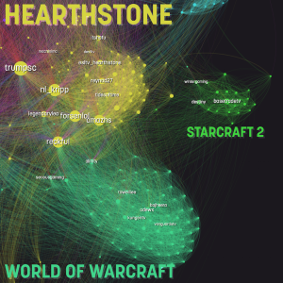

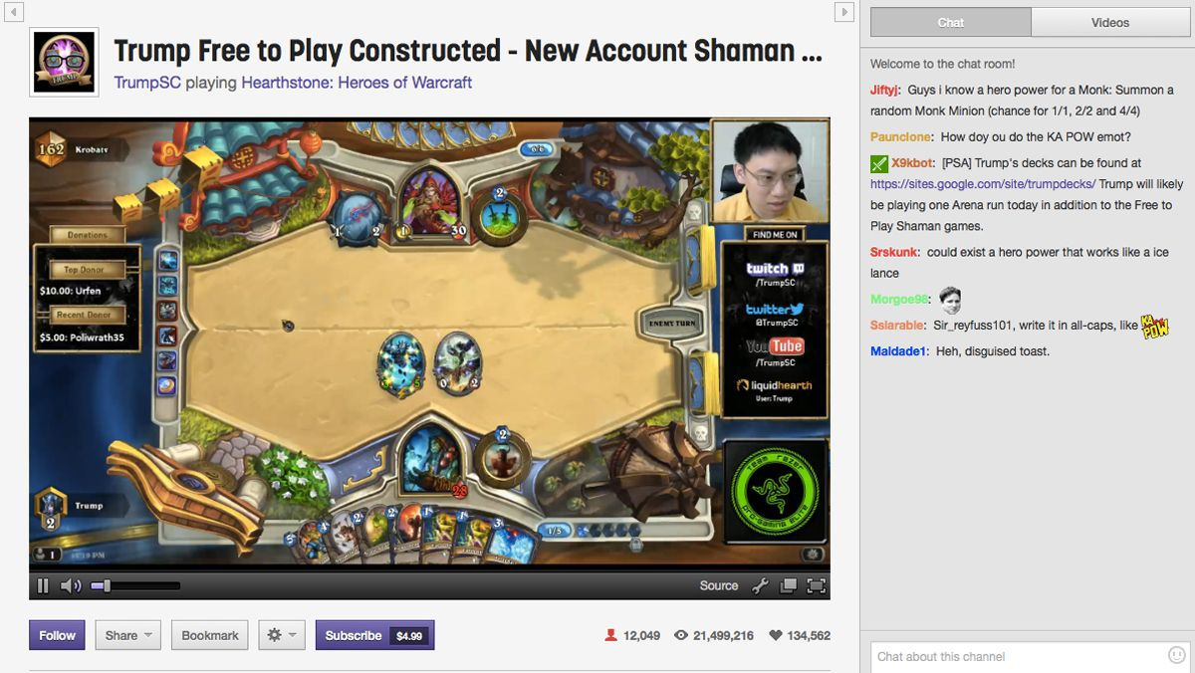
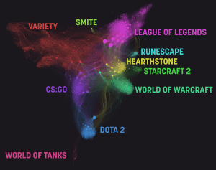
What is it good for?

Slide 3

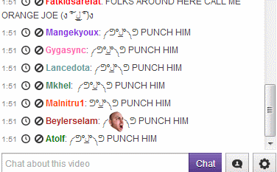
What is it good for?

Slide 4
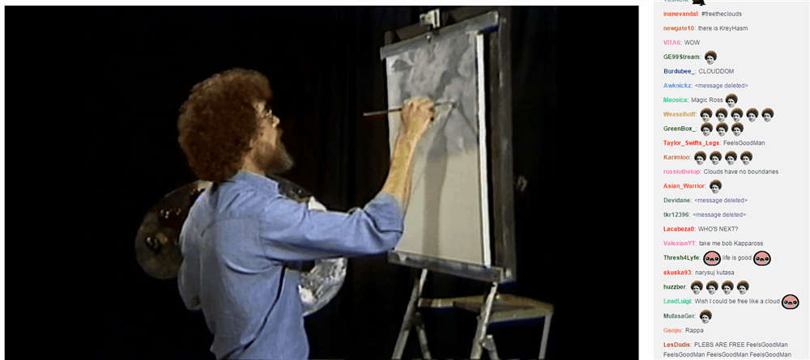
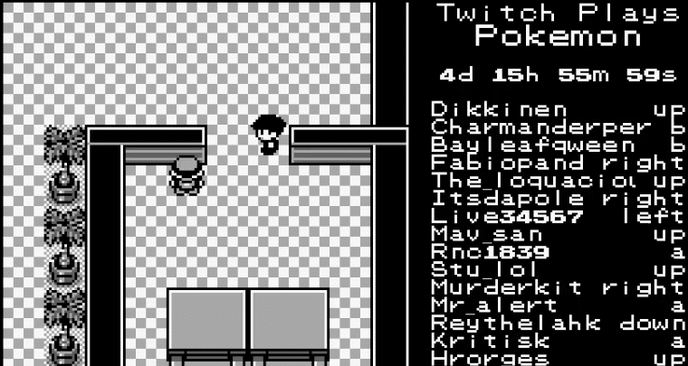
What is it good for?
Twitch Community Events

Slide 5

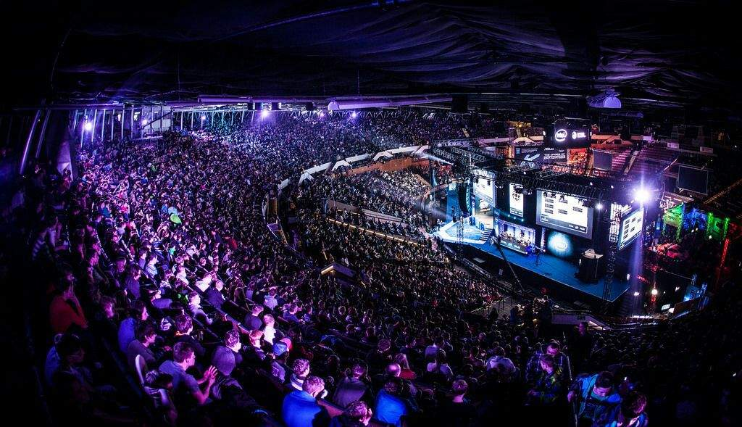
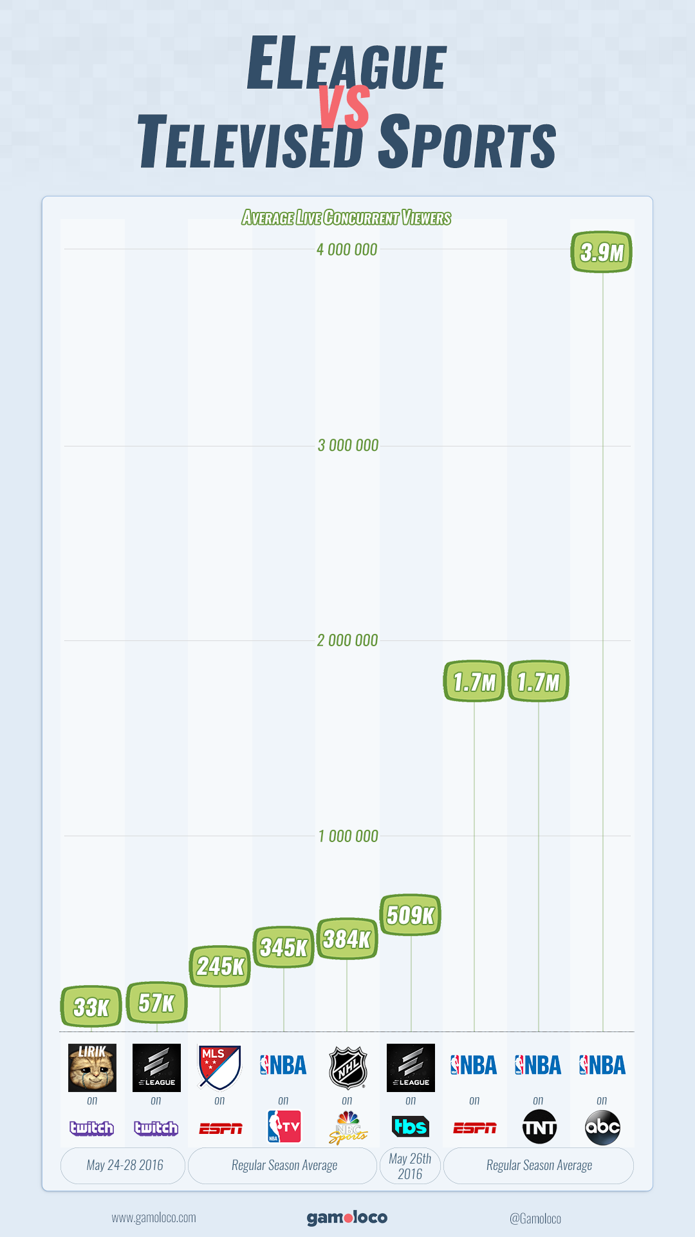
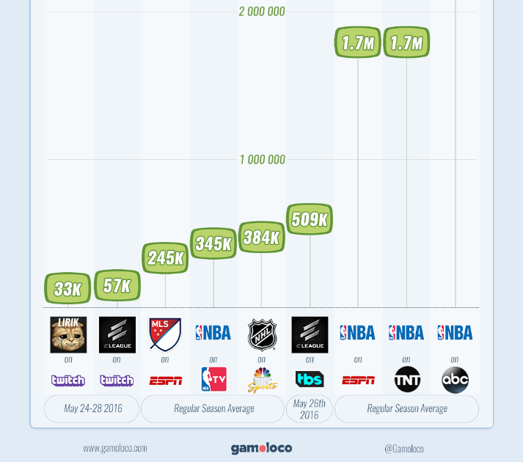
Inspiration
Massive viewership for esports events
Wanted to forecast viewership for future events

Slide 6
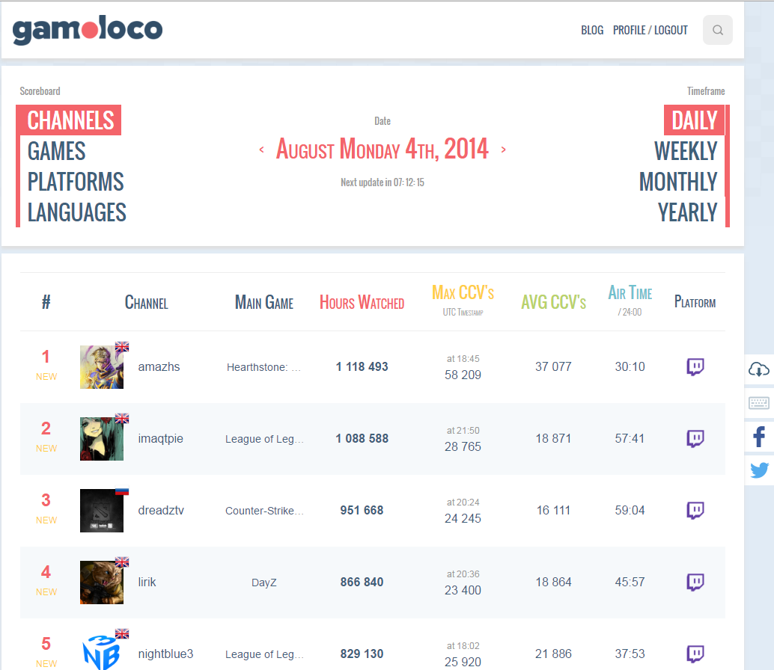

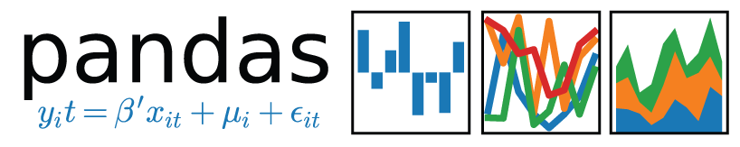

THE DATA
Twitch.tv currently the 4th largest data stream in the world.
Required historical data
Scraped daily data tables from gamoloco.com

Slide 7
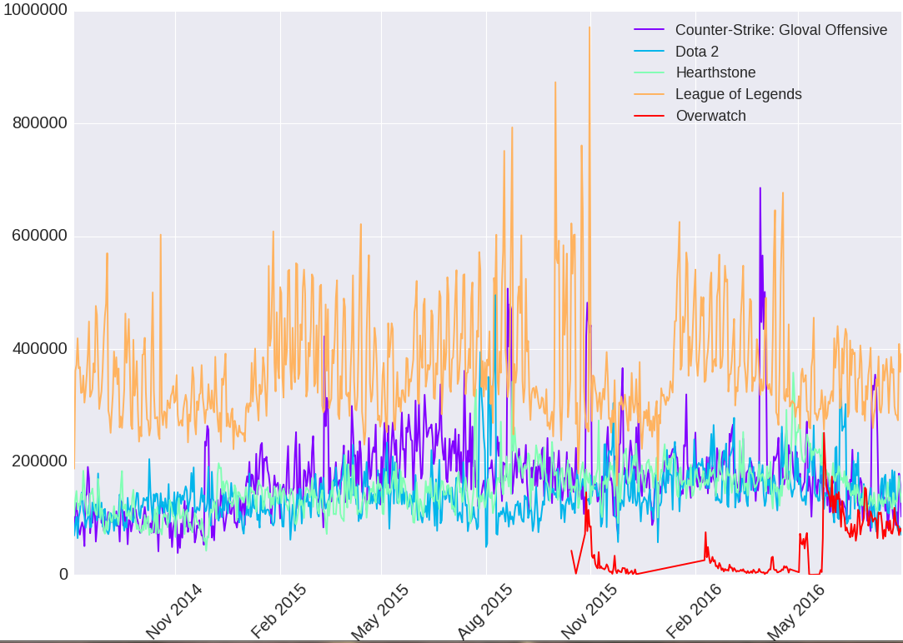



The EDAwakening: Becoming one with data
Top5 Games Average Viewership

Slide 8
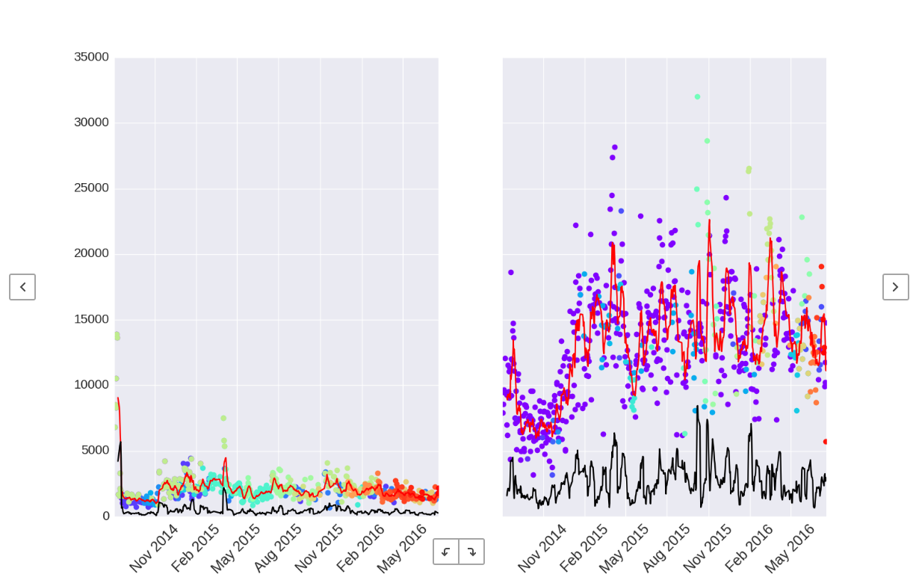
High volume streamers: a detour
Average Continuous Viewers for destiny and summit1g
Changing color represents changing the main game being streamed.

Slide 9


Finding the signal
statsmodels - ARIMA
RandomForestRegressor
GradientBoostingRegressor
Ridge Regression
Lasso Regression
Hyper parameters vary for individual channels

Slide 10
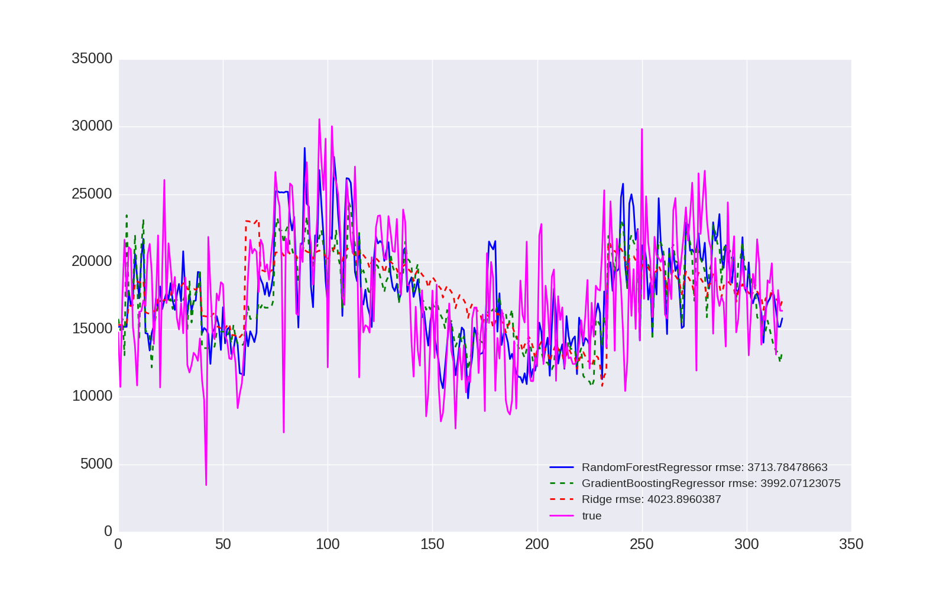

Forecasting: weatherman in colorado
Average viewership forecasts for imaqtpie

Slide 11
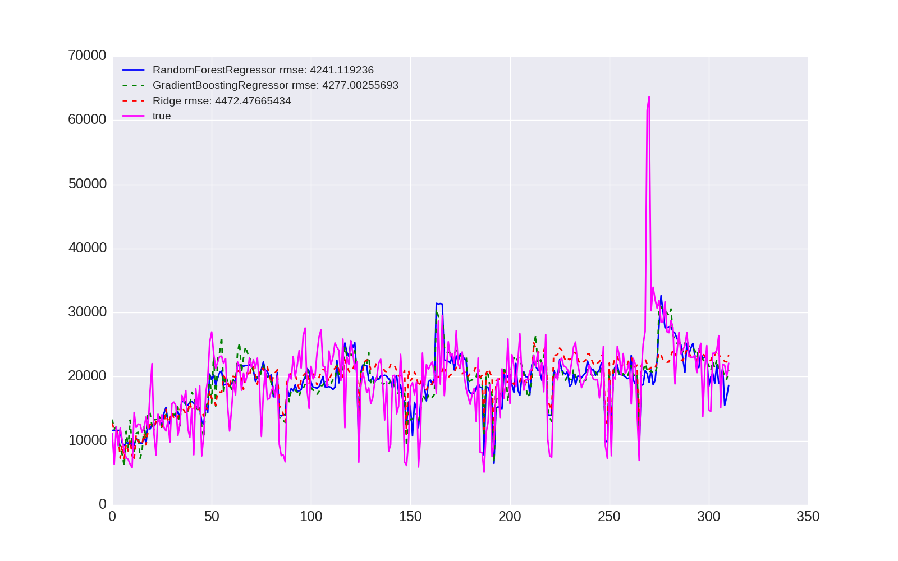
Forecasting: weatherman in colorado
Average Viewership forecasts for nl_kripp

Slide 12
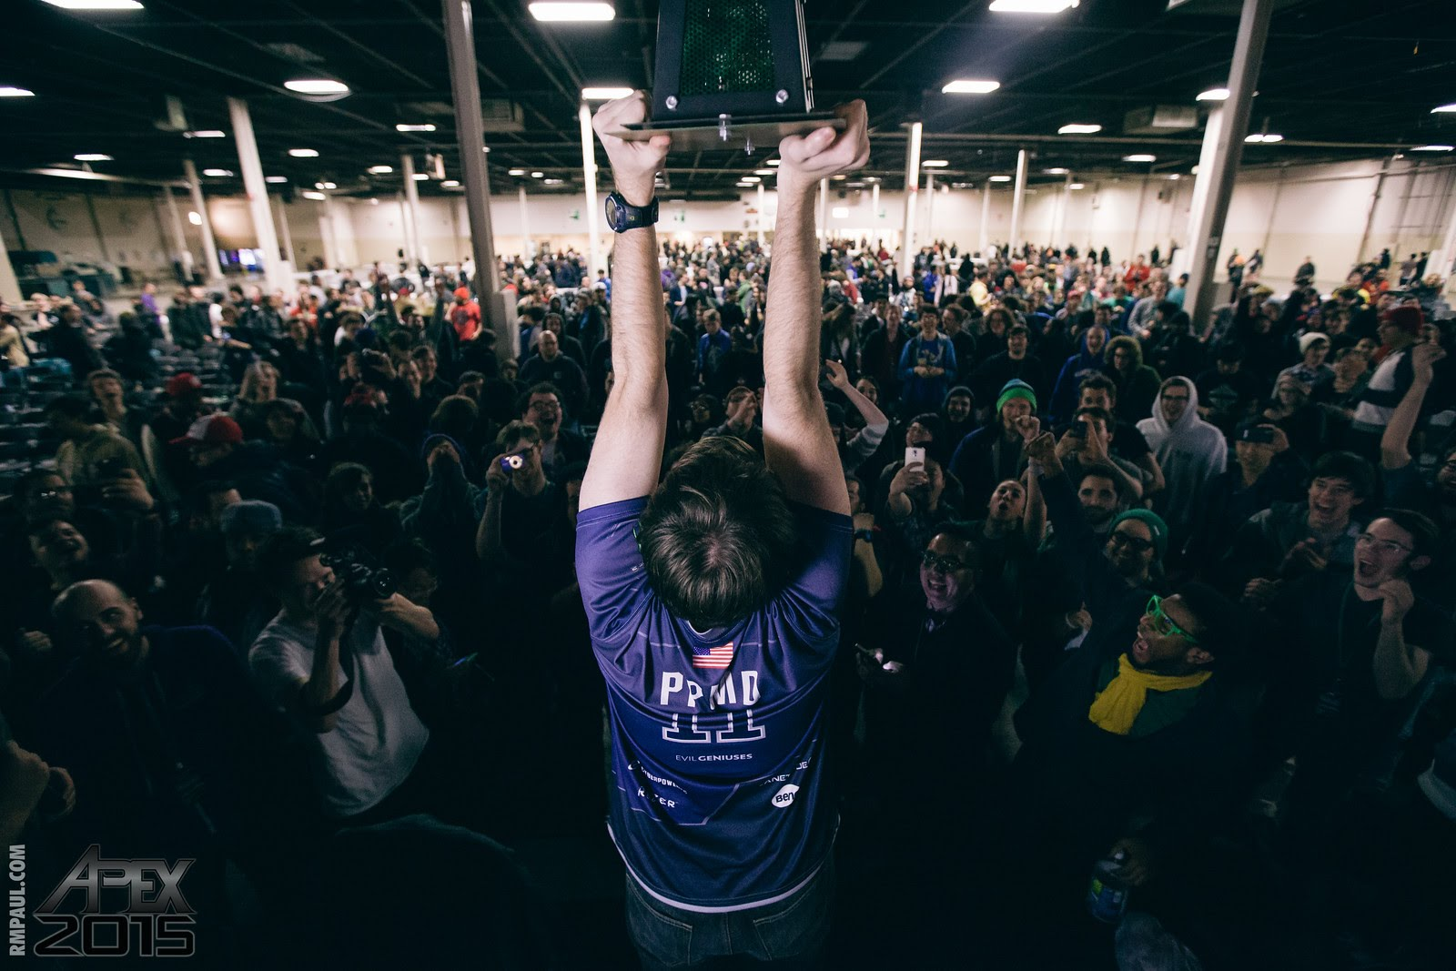
Gifts of Future Forecasting
Generalize for any channel
Incorporate Graph Theory
Stream in data directly from twitch for auto updating

Slide 13
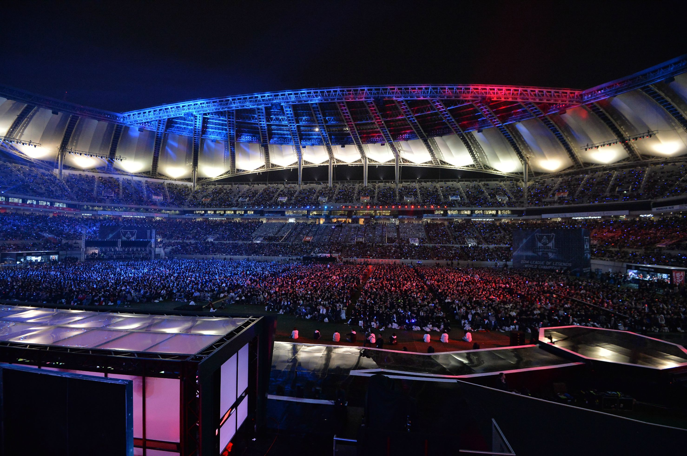



questions?
github.com/p2501g2
Linkedin.com/in/dfreund2501

Slide 14
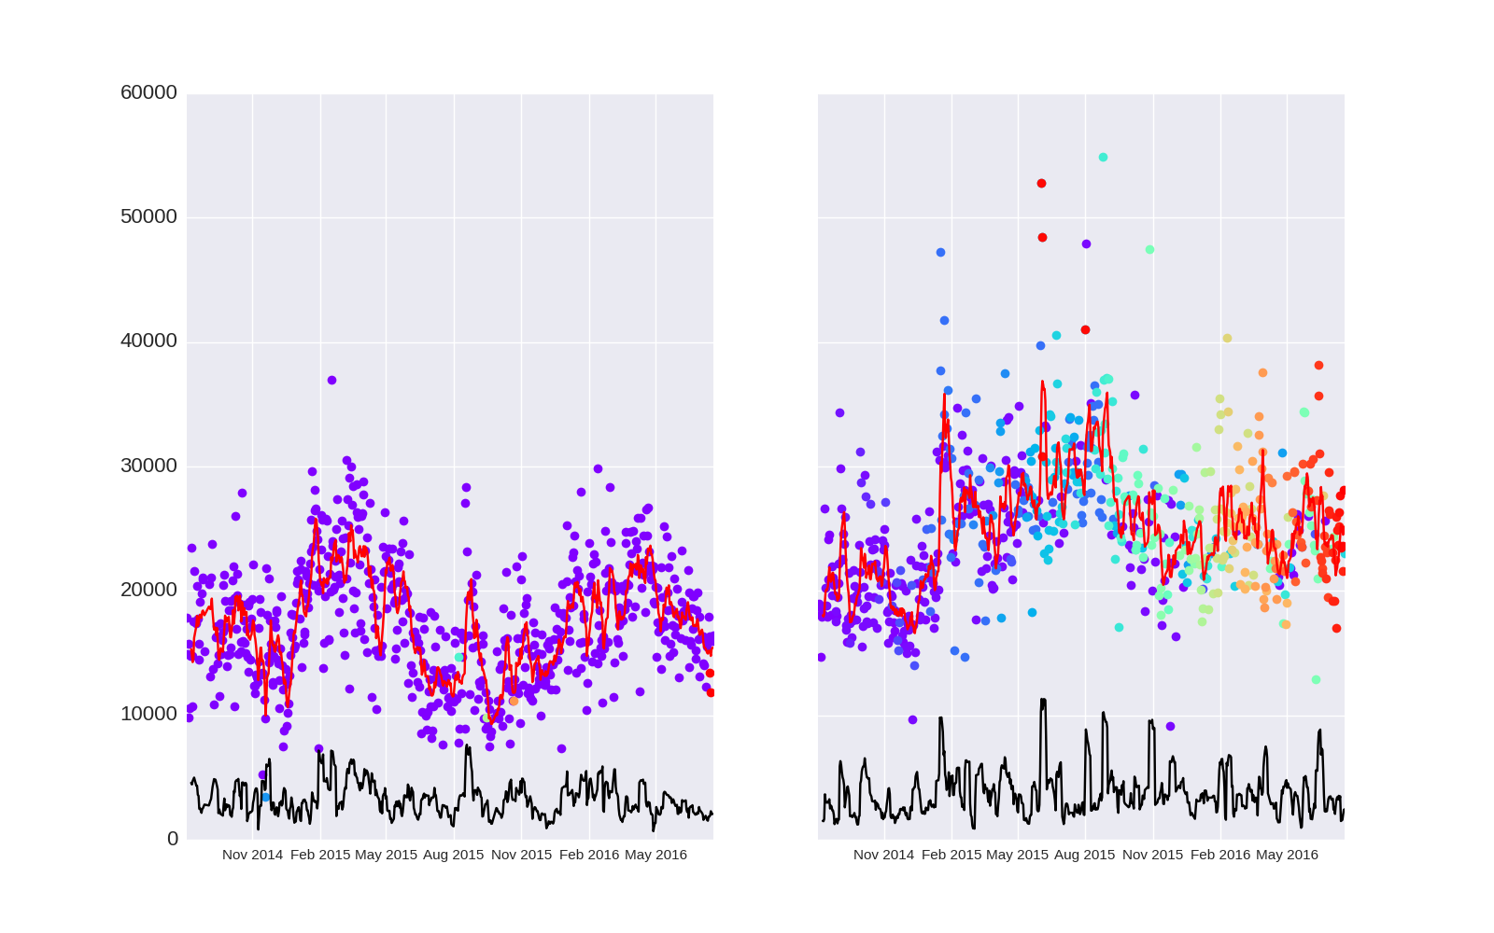
High volume streamers: a detour
Average Continuous Viewers for imaqtpie and lirik

Slide 15


The EDAwakening: Becoming one with data

